Slide 1
Project Js
Project Made By Zyad Eloussoul
JS,html,css,php Courses

Slide 2
Sign Up page
SignUP.js
Home Page
CONTENTS
Home.js
ALL courses Page
Script.js

Slide 3
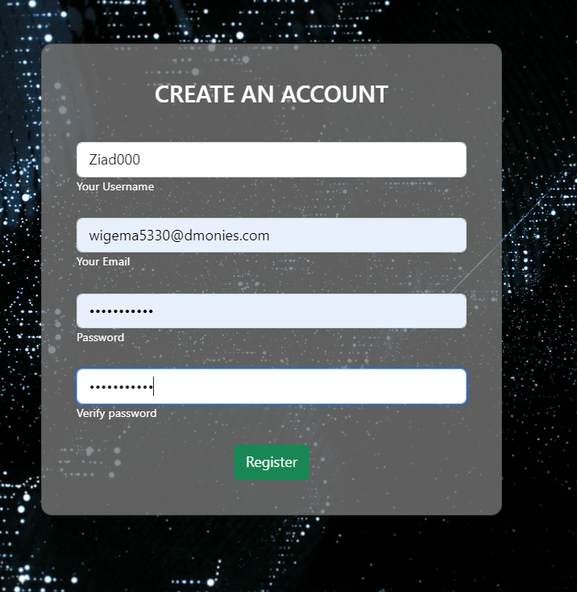
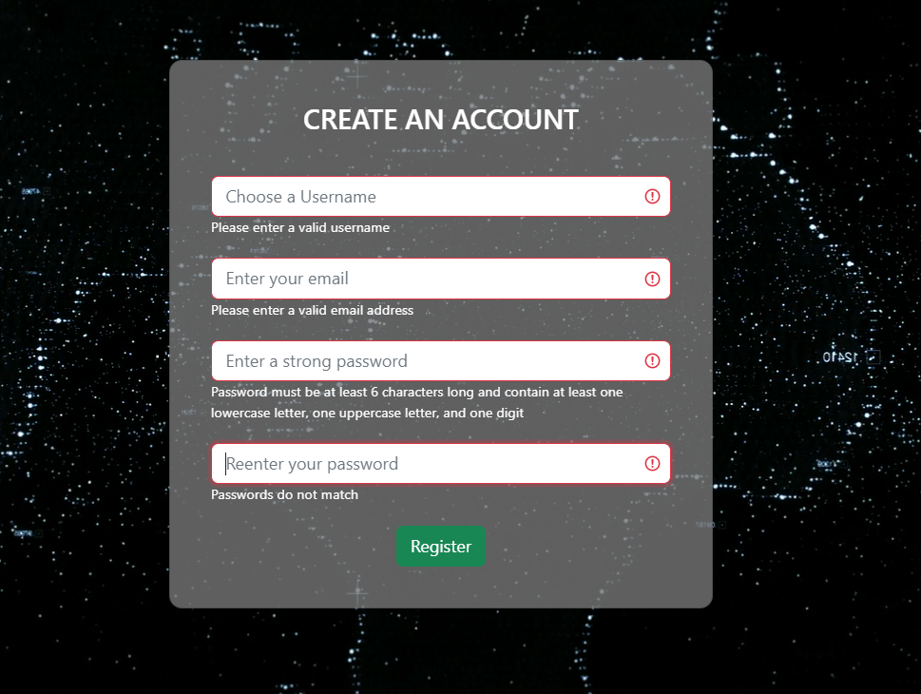
Add Your Website
Enter title
Sign Up
Valid inputs
inValid inputs

Slide 4
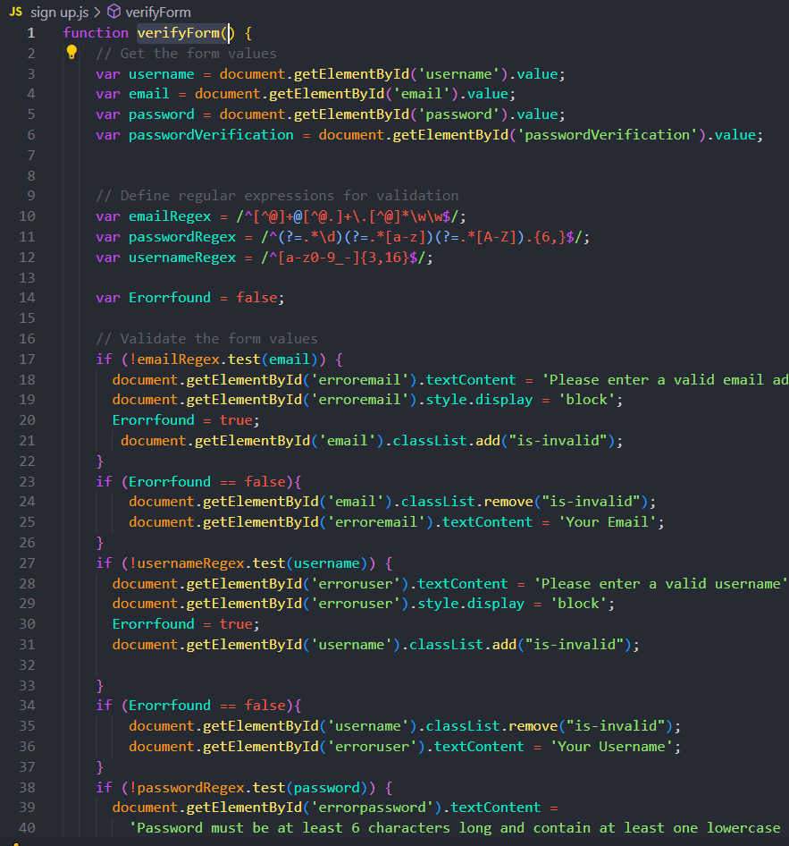
VerifyForm() Function
to perform the input check i used this function witch declares variables containing regex codes of every input
and a variable ErrorFound that takes the value true if an error is found in the form
and compared the regex codes with the inputs given by the user if they dont match the Errorfound variable will be true thus making the submit button unable to redirect the user to the home page

Slide 5
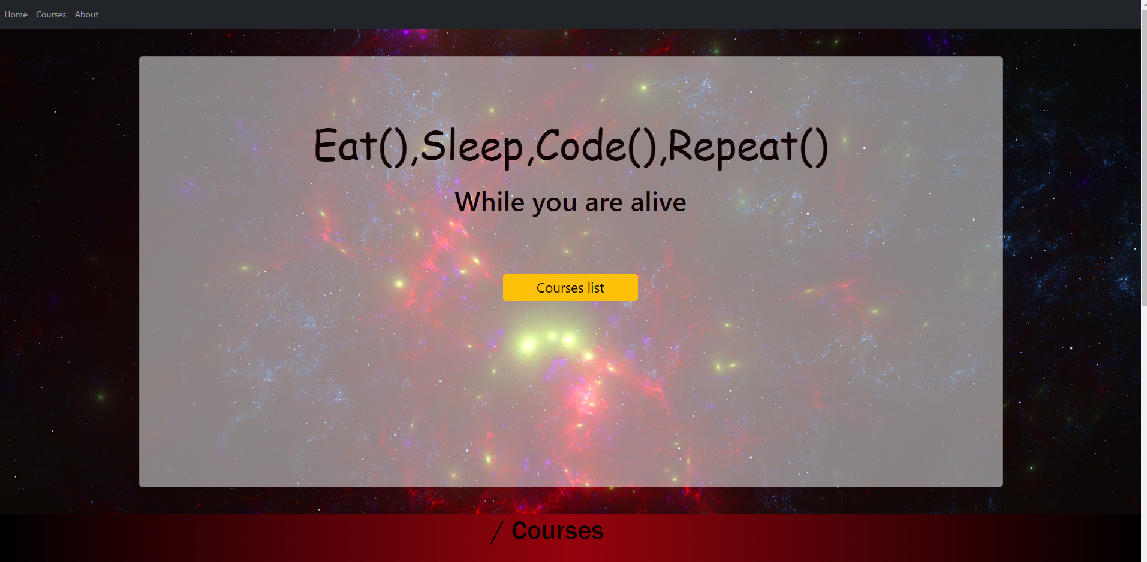
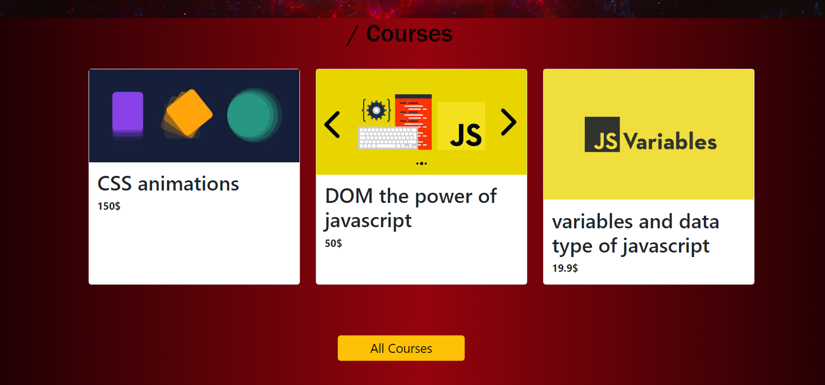
Home Page
all buttons will redirect to the courses page
The three courses are genrated randomly

Slide 6
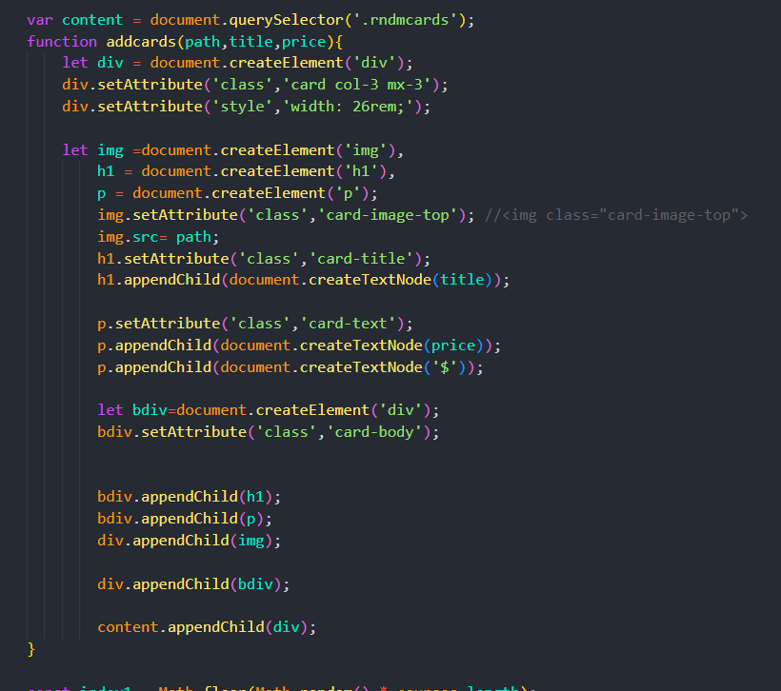
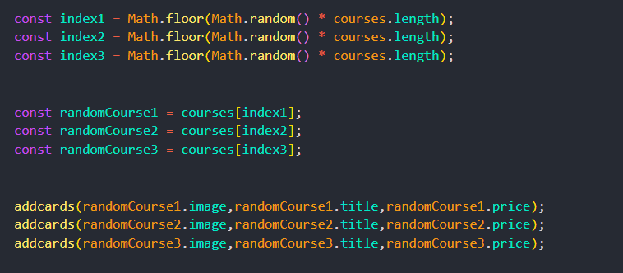
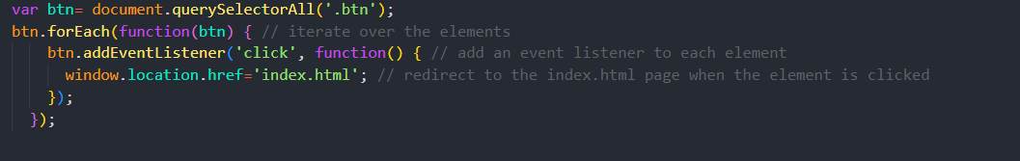
Addcards() Function
i used 3 variable img,h1,p to create the title ,price and the image of the card
and i used the function Appendchild() to put the variables inside the «content» div
the function math.floor() and math.random()
to import the indexes of 3 random cards from the file courses.js and used the previous function to display them
I used Query selector to make all the buttons in the page redirect to the next page

Slide 7
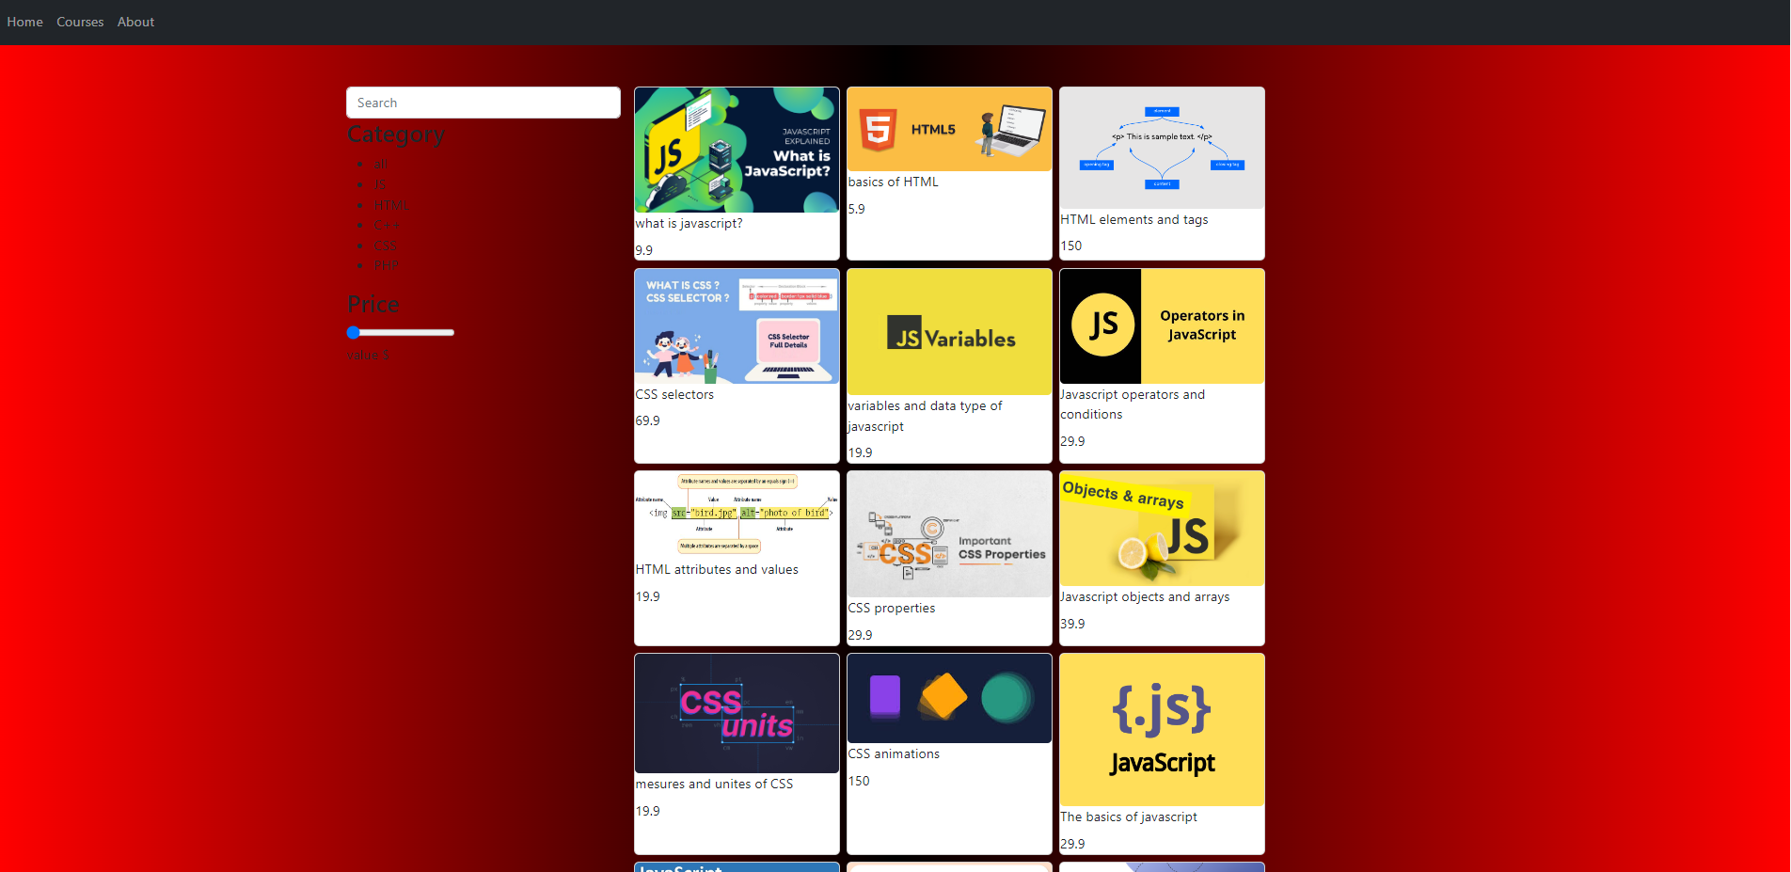
Add Your Website
Enter title
Courses Page

Slide 8
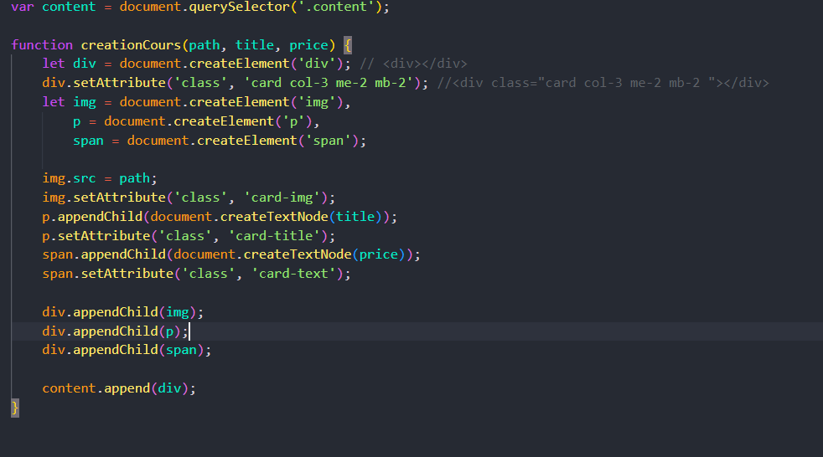
The Function CreationCours()
i used the function appendchild and setAttribute to create to display all the cards

Slide 9
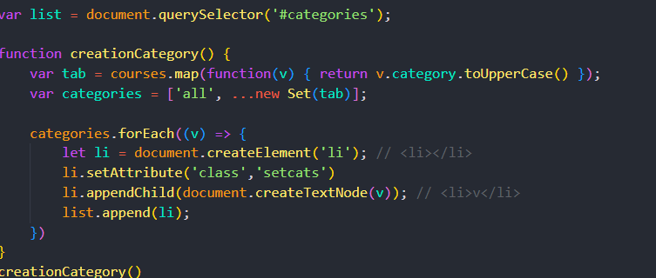
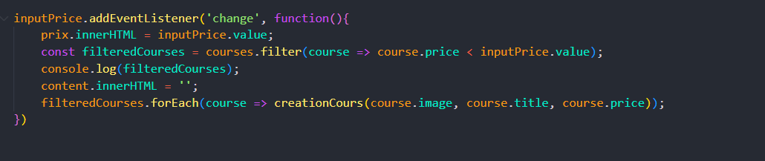
CrreationCategory() Function
i used the map function to put all the categories of the courses in «courses.js» in an array the diplayed them as lists
Filtring By price
i used the filter function to put all the filtered courses in an array «filtered courses» and then displayed it after clearing the page

Slide 10
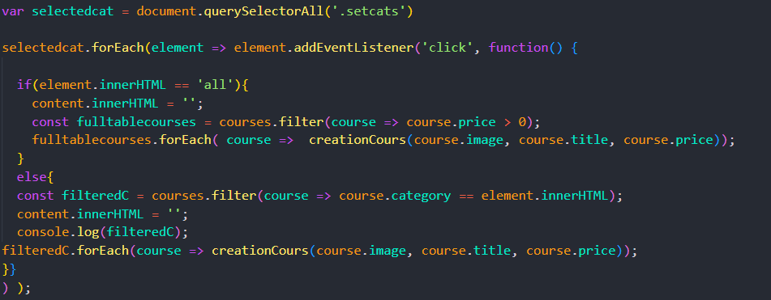
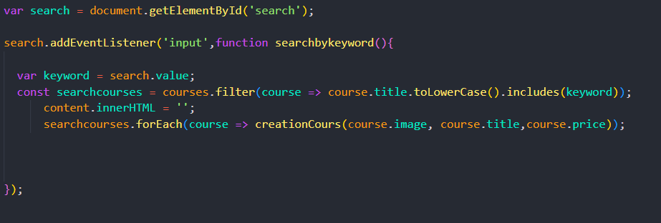
Filtring By Categorie
i used the foreach loop to go through all the categories the check if they are clicked by the addeventlistener then
used the filter function to check if categorie is «all»
if thats true the all courses are displayed if not it will display the courses depending on the categorie clicked
Filtring By Search Keyword
i used a listener on the searchbar by input
then declared the SearchByKeyword() function
inside this function i used tolowercase().includes(«the given keyword»)
to grab the key word and compare it to the title of everty course thus diplaying only the courses that math the keyword

